Slide 1
CRNN Chinese characters

Slide 2


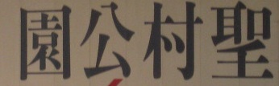
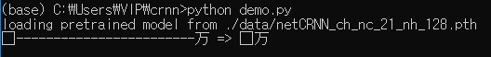

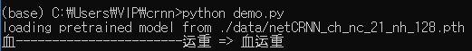
Demo.py

Slide 3
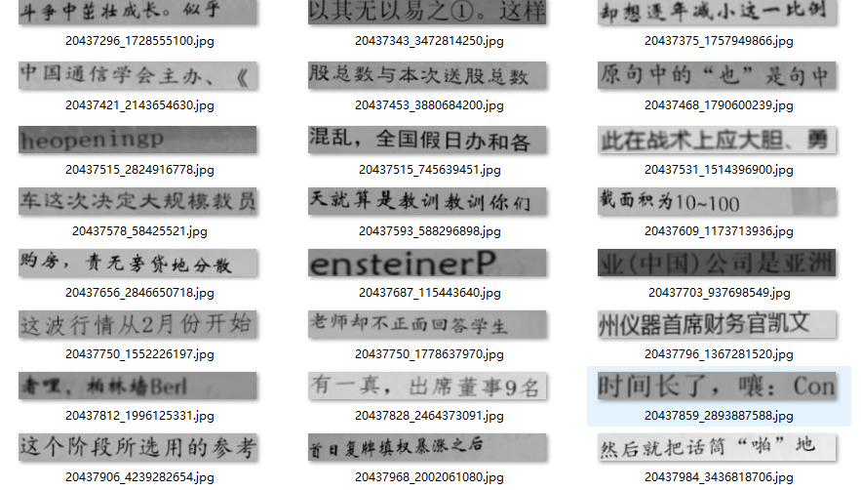
Dataset - https://github.com/Sierkinhane/crnn_chinese_characters_rec

Slide 4
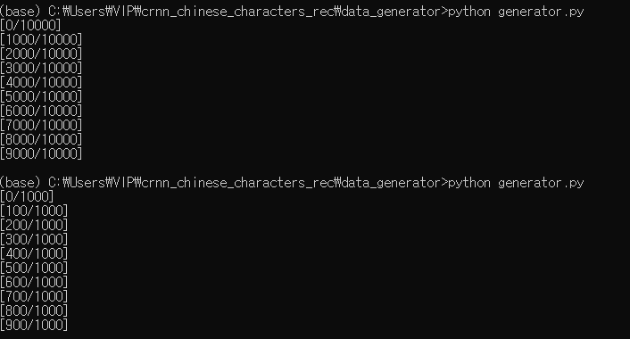
Dataset Generator

Slide 5
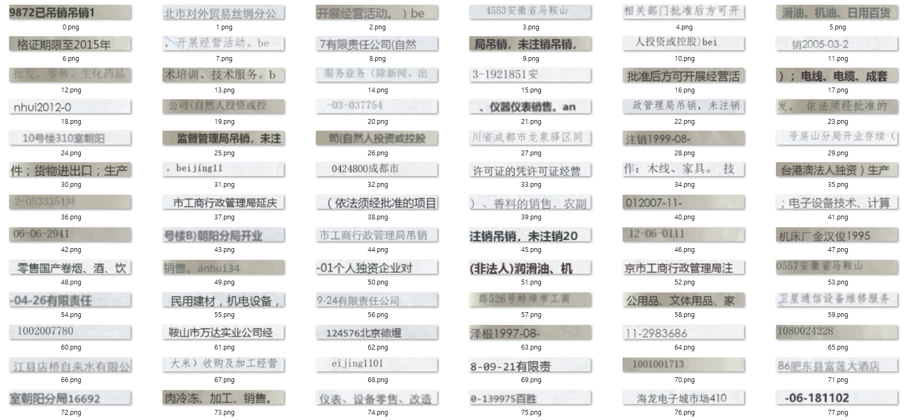
Dataset Generator – 280 * 32

Slide 6

Dataset Generator -> lmdb

Slide 7
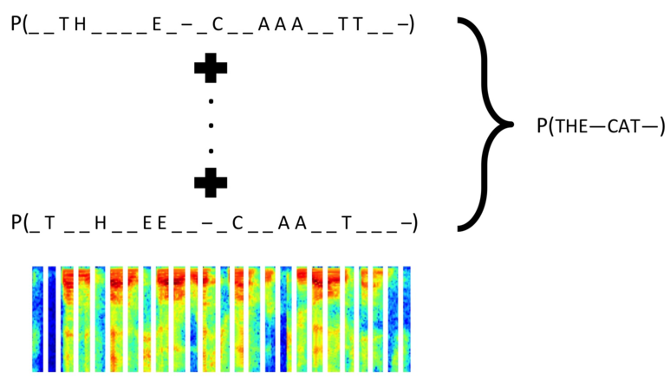
warp-ctc

Slide 8
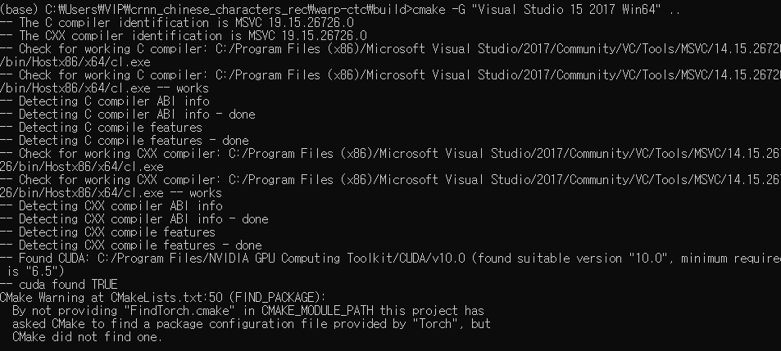
warp-ctc

Slide 9
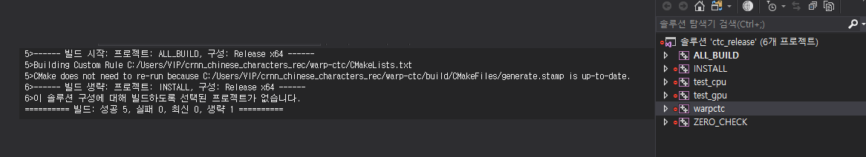
warp-ctc

Slide 10
warp-ctc setup.py

Slide 11
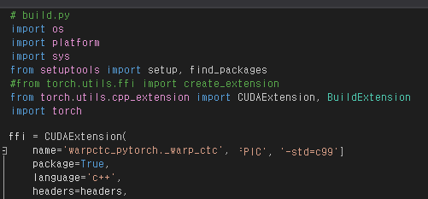
warp-ctc setup.py

Slide 12
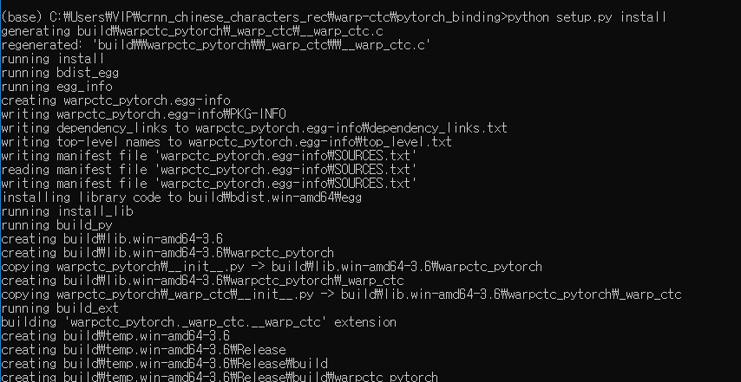
warp-ctc setup.py

Slide 13
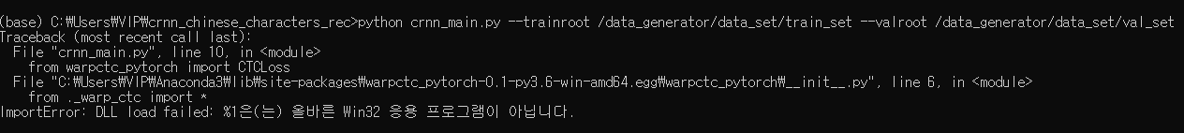
warp-ctc setup.py

Slide 14
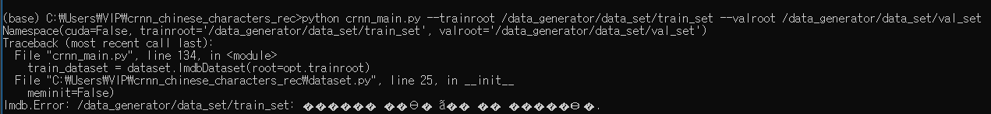
crnn_main.py

Slide 15
crnn_main.py

Slide 16
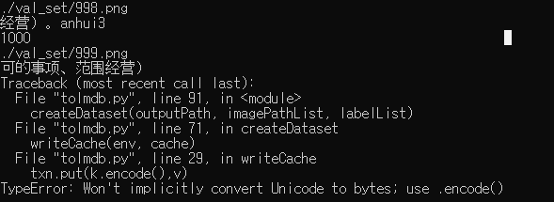
tolmdb.py

Slide 17


tolmdb.py

Slide 18
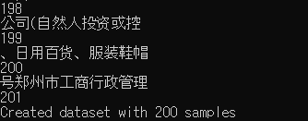
tolmdb.py

Slide 19
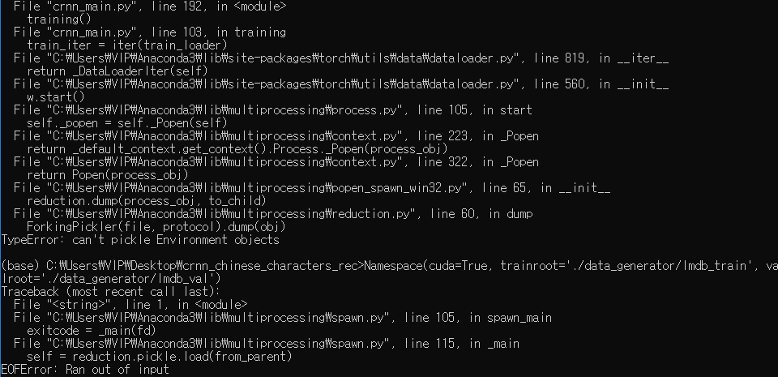
crnn_main.py

Slide 20
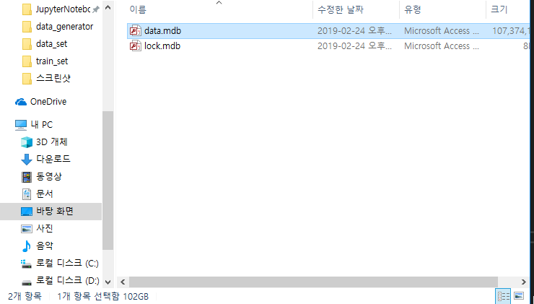
crnn_main.py

Slide 21

tolmdb.py

Slide 22
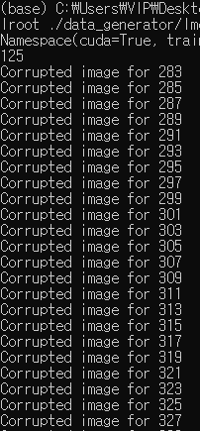
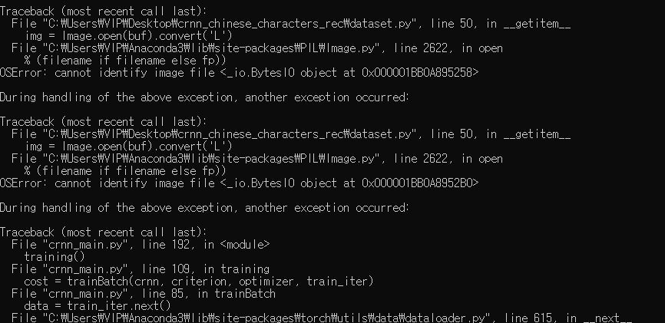
crnn_main.py

